Slide 1
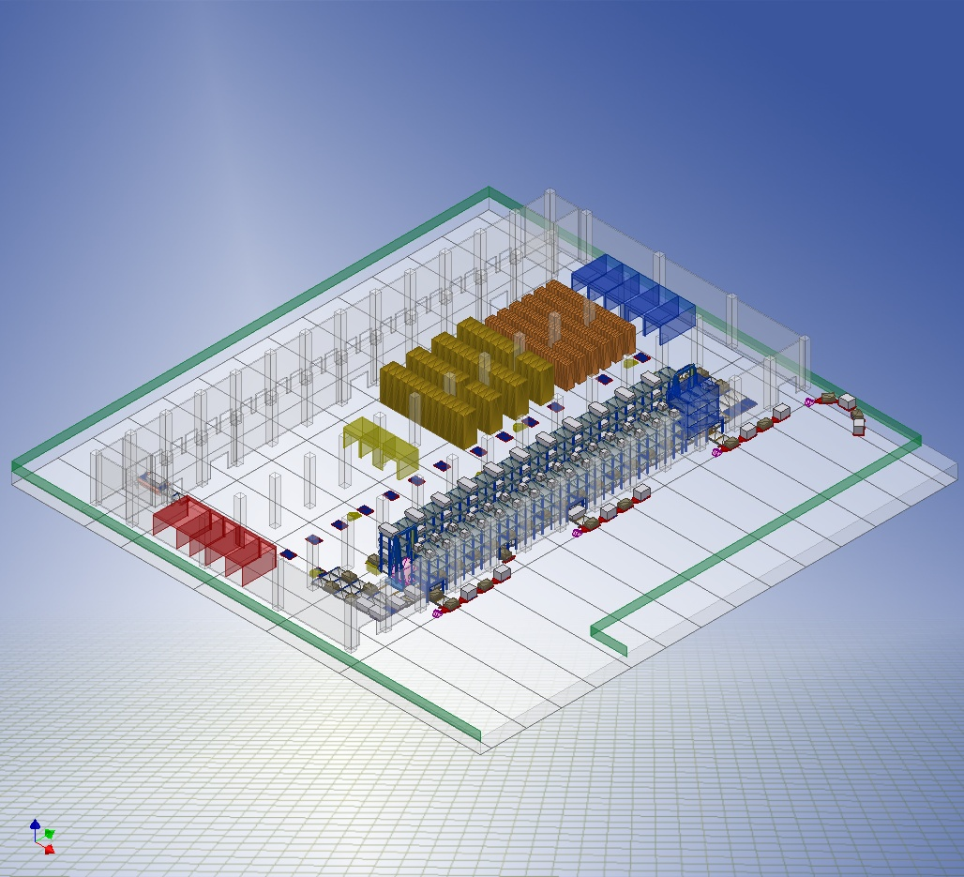
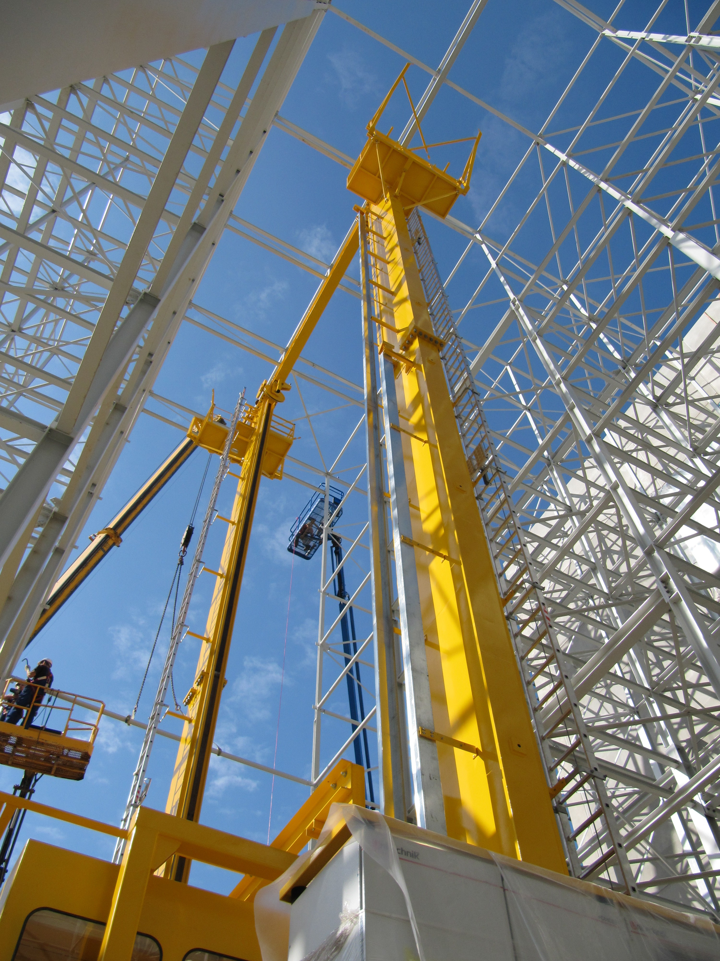
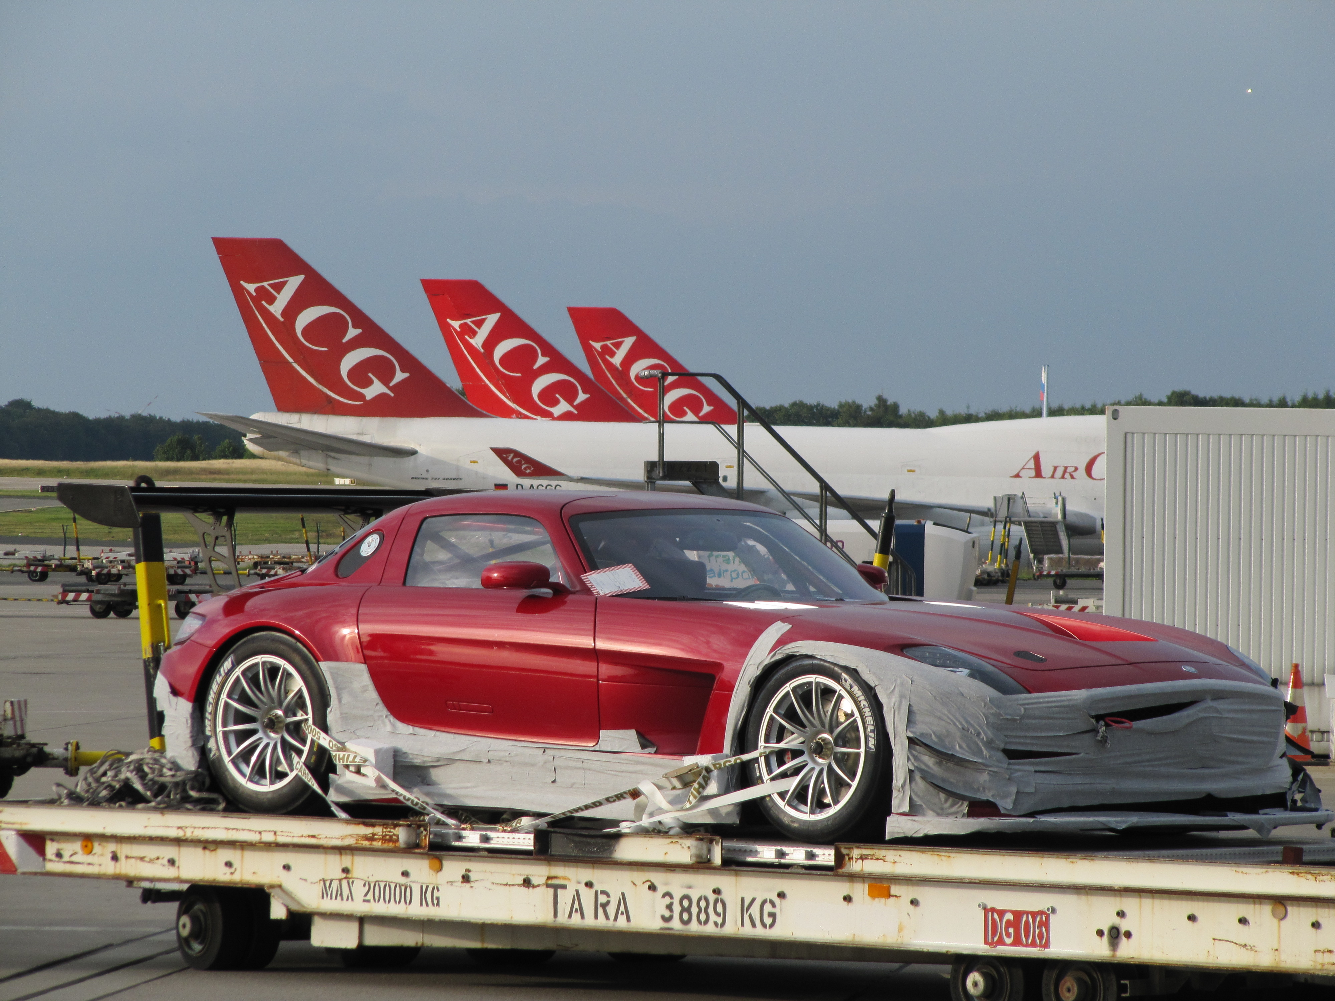
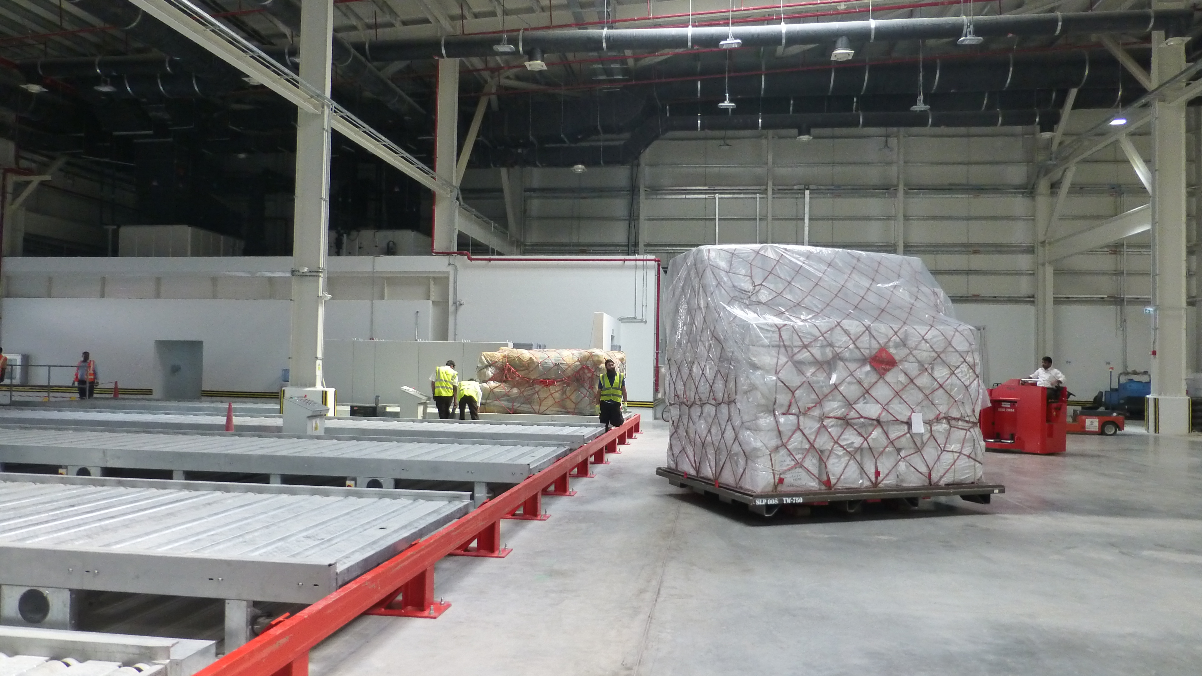
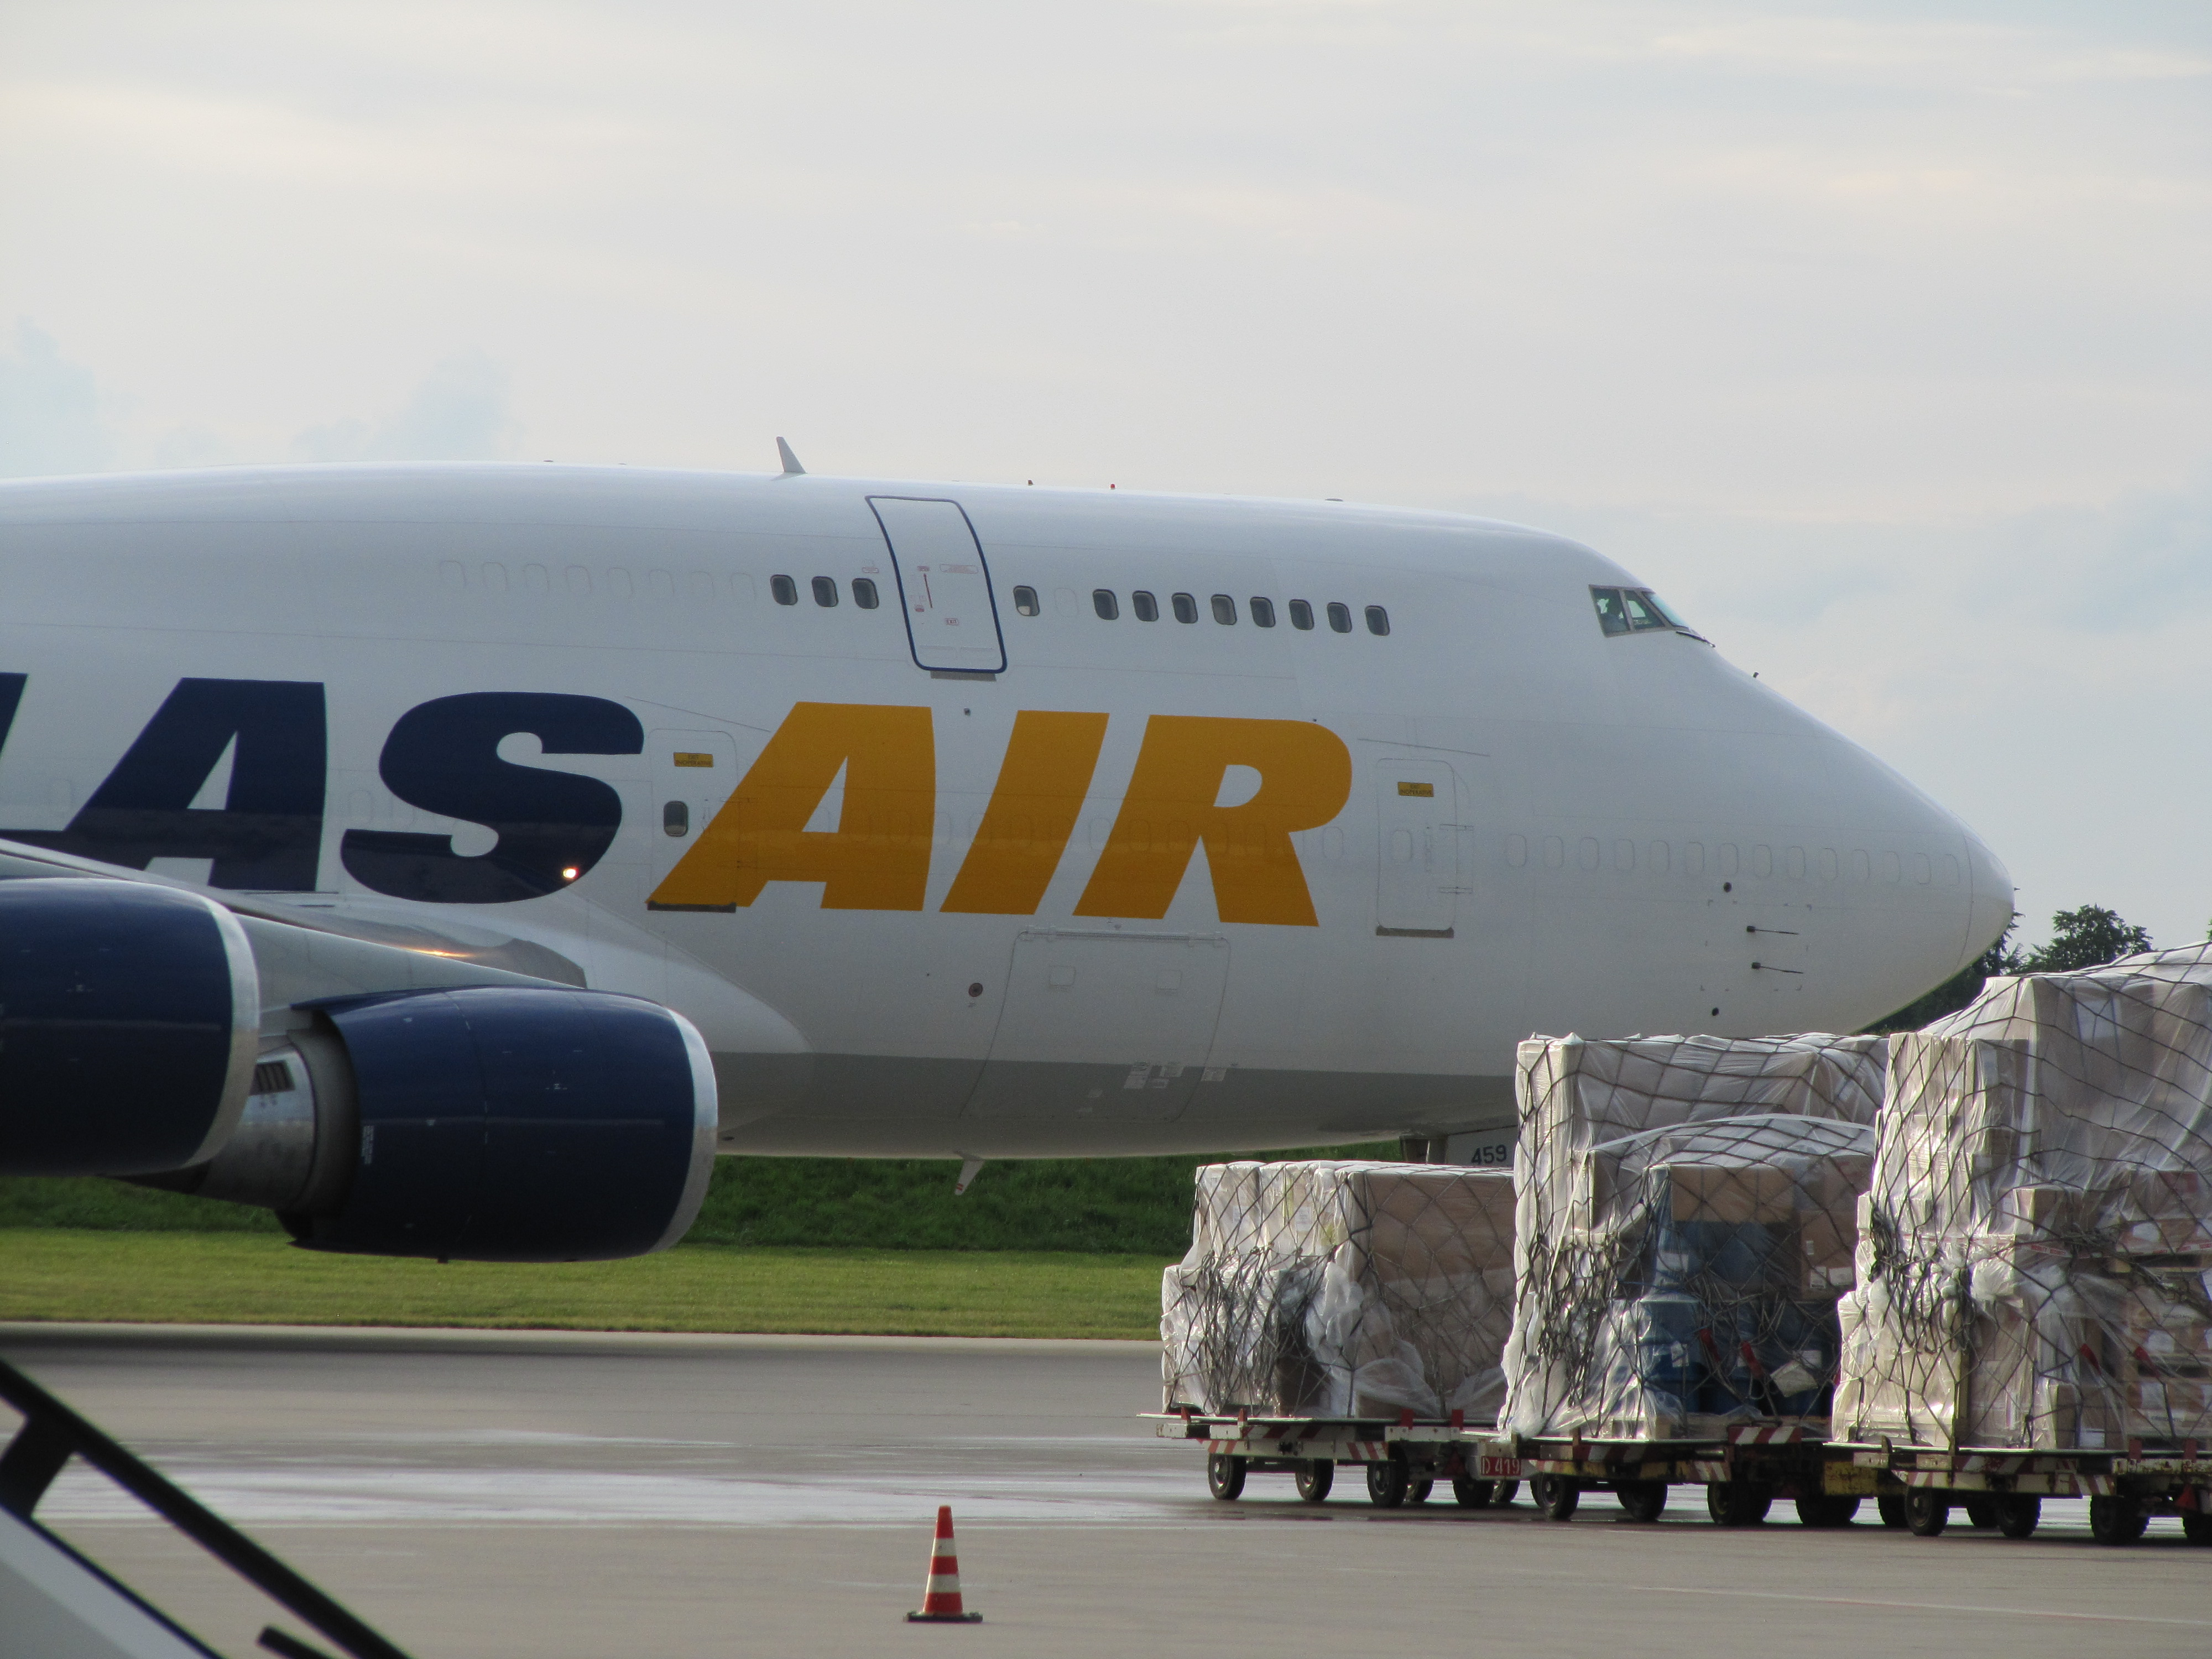
Becon Projects
Air Cargo Consultancy
© 2021 BECON-PROJECTS GmbH D-65510 Idstein – Germany

Slide 2
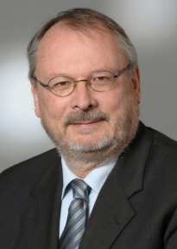
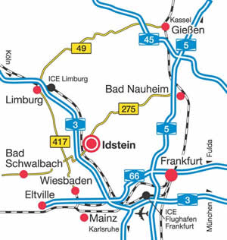
About us
BeCon Projects
BeCon Projects GmbH founded August 2009
Headquarters Germany, 40 km from Frankfurt/M
Group CEO: Uwe Beck
BeCon Projects LLP South-East Asia
Singapore
BeCon Projects LLC Middle East
Dubai

Slide 3
Areas of expertise
We are the leading Consultant in Air Cargo Facilities & Operations
Design
MHS
Operational Optimization
Operational Reviews
IT Integration
CMS Integration
Project Realization
Automation
New Techs (e.g. RFID, image capture, robotics)
Analysis SOPs
Operational Re-engineering
Flexible Warehousing
Architectural pre-design
Training
Project Management
ORAT
Master planning
Multi tenant

Slide 4
Areas of expertise
We are the leading Consultant in Air Cargo Facilities & Operations
- High detailed technical expertise (Mechanics, Electrics, IT)
- Interfaces
- Design of systems (Throughput analysis – Operational reviews)
- Strong Operational Back-Ground

Slide 5
How we work
Experience
Partnership
Open dialogue
Interdisciplinary
Task in Air Cargo
Client
BeCon Projects
Opportunity
Notes:
Solution?

Slide 6
Successfully finalized
COOL Cargo Project Management MHS/ IT
Gerry’s dnata Karachi: New Import Terminal
MHS Efficiency Review Analysis
Integration Module I & FG1
Design Concept New Cargo Terminal
Simulation existing CMT/FG1 at DXB
New 800 TT Cargo Terminal Amsterdam Airport
Toronto: Terminal conceptual design & analysis

Slide 7
Current Projects
Changi Airport – Master Planning New Cargo Area - Finalized
Air Baltic, Riga New Cargo Warehouse incl. E-Commerce/Mail - Finalized
WFS, BRU New Cargo Warehouse 350.000 Tons annually - Ongoing
WFS, JFK New Cargo Warehouse 400.000 Tons incl. apron traffic steering - Ongoing
Cargogate Munich – IT Consultant CMS System replacement - Finalized
Amman New Cargo Terminal - Ongoing
Swissport Tanzania – Expansion of existing Pharma/PER facilities - Ongoing
Dnata Amsterdam – New Cargo Warehouse 800.000 tons annually - Ongoing
Saudia Cargo Riyadh ORAT Project - Finalized
Air New Zealand, Auckland – New Cargo Hub 400.000 tons - Ongoing

Slide 8
Membership
Corporate Member of “The International Air Cargo Association“ TIACA
Member of “Air Cargo Club Germany“
Member of VDI “Verband deutscher Ingenieure“

Slide 9
We believe in
“Form Follows Function”
Or
Do not let the building take the lead !!!

Slide 10
Our Principles
Facility & Infrastructural Planning
Phase 1: Design and Definition Phase
Design Parameters
Operation
IT Level
Functionality
Interfaces to Stakeholders
“Form Follows Function“
Or Do NOT let designing the building take the lead!
Design Brief
Concept MHS-OPS Design
Architect
Pre-Design
Budgets
Green Light

Slide 11
Our Principles
Facility & Infrastructural Planning
Phase 2: MHS/ Construction Tender
MHS RFP Tender Description
IT RFP Tender Description
Construction Tender Description
Legal support
FIDIC
“The Engineer“
Shortlist – Evaluation – Negotiation – Contract Award
Start Project

Slide 12
Our Principles
Facility & Infrastructural Planning
Phase 3: Project Management
Project Management
Realistic Milestones
Clear Reporting Structure
Scheduling & Budget Control
Change Order & Crises Mgmt.
Open Communication
Acceptance Procedures
Notes:
Clear and realistic Milestones
Clear Reporting Structure
Acceptance Procedures
Scheduling
Budget Control
Change Order Management
Crisis Management based on trust and open communication between
all parties involved

Slide 13
Pool of experience
Our team has been involved in major developments of Air Cargo Terminals
Accumalating 250 Man Years Experience in Air Cargo
KLM: Schiphol Freightgate 3
SATS T5 & T6: Singapore Changi Airport
BAWC: London Heathrow
ACC: Malaysia Airlines, KL
NCA: New York, JFK
DNATA: Freightgate 5, Dubai International Airport
Swiss Cargo: Zuerich Airport
Lufthansa Cargo: LCC Neo Frankfurt Airport
Finnair Cargo: Cool Nordic Cargo Hub, Helsinki Airport

Slide 14
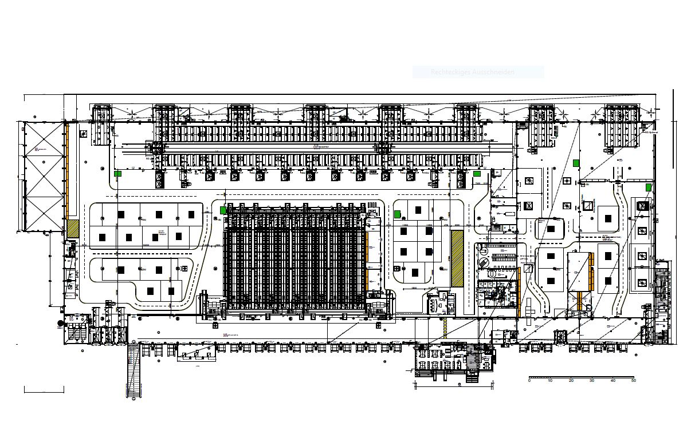
Finnair Cargo
COOL Nordic Cargo Hub
BeCon Projects: “Engineer & MHS Project Manager MHS development & integration”

Slide 15
Finnair Cargo
COOL Nordic Cargo Hub
BeCon Projects:
“Engineer for Supervision & Project Management of the MHS integration”
Special Demand 80 % transshipments
Fast internal Transports efficient handling of transhipments
Modular Design allow for future growth
Automation reduce high labour costs & increase handling quality
Special Areas Pharma & Fish guaranteeing an unbroken & monitored cool chain
IT Aspects
High degree data interfacing, i.e. forklift management & shipment control

Slide 16
Finnair Cargo
COOL Nordic Cargo Hub
Architectural Pre-Design

Slide 17
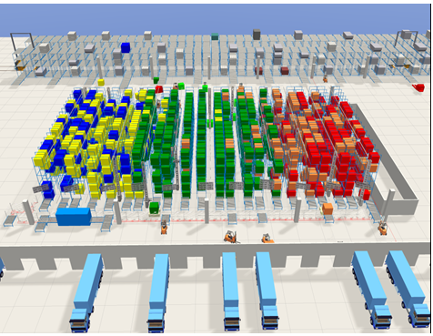
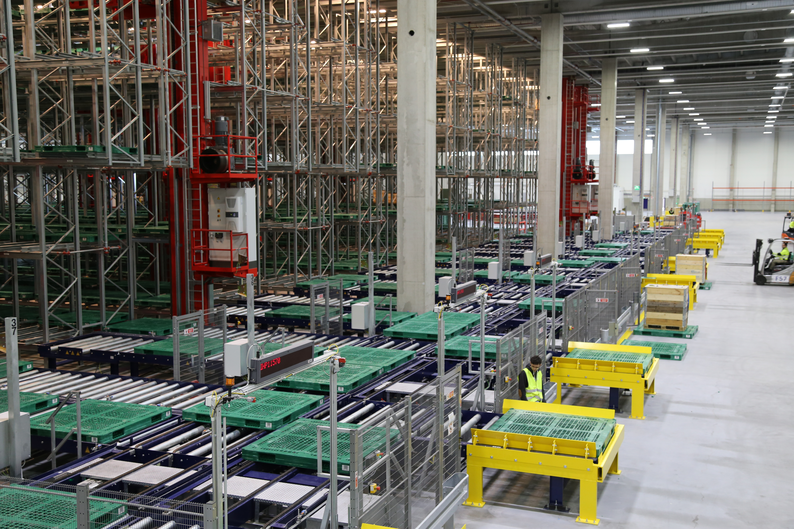
Finnair Cargo
COOL Nordic Cargo Hub
Our custom designed AS/RS shipment handling System
High speed shipment distribution system landside & airside

Slide 18
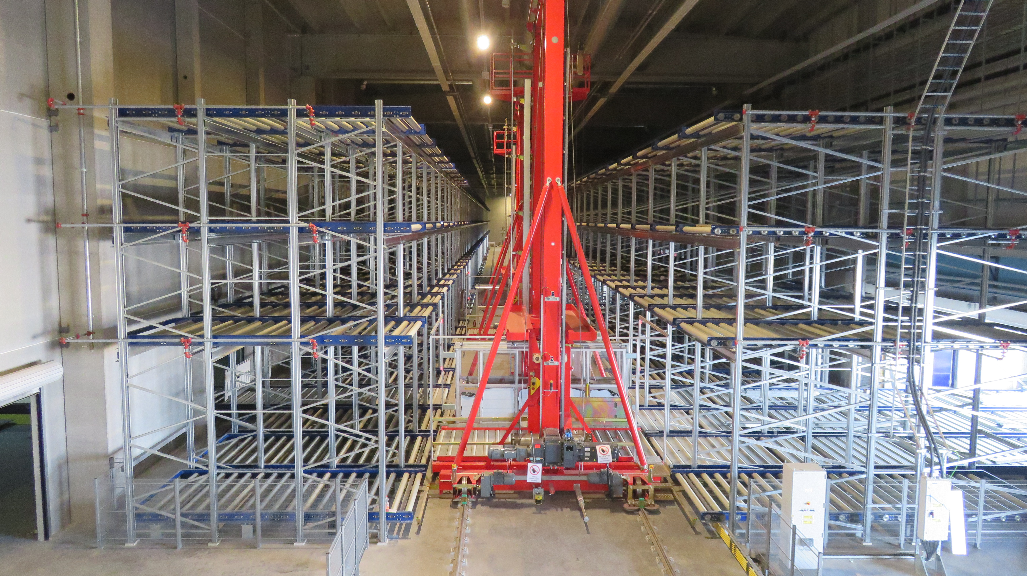
Finnair Cargo
COOL Nordic Cargo Hub
Our custom designed ETV System

Slide 19
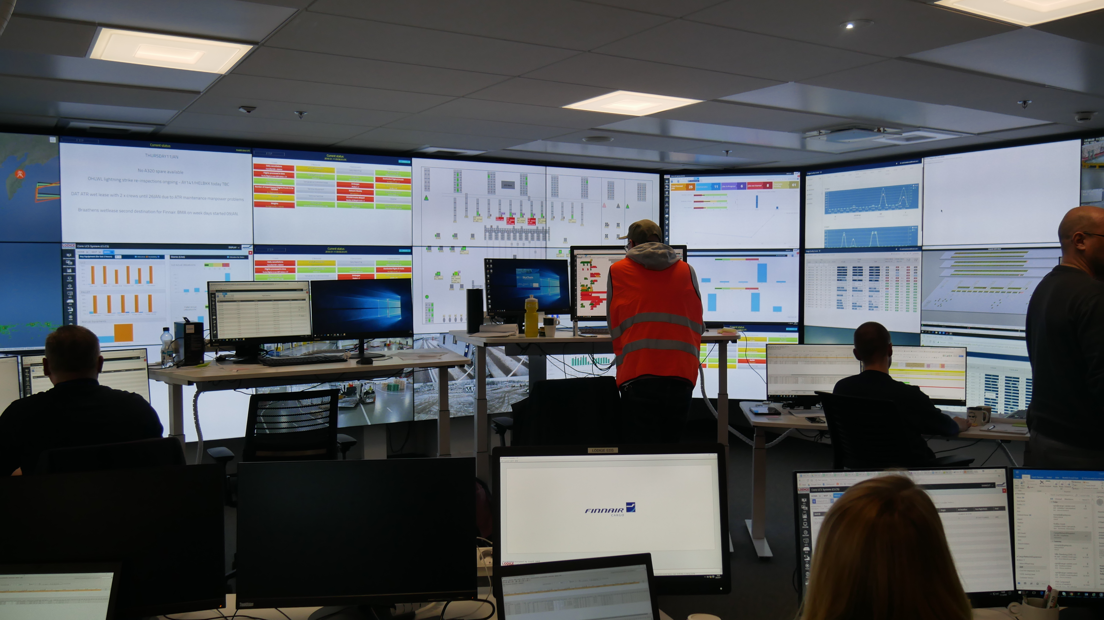
Finnair Cargo
COOL Nordic Cargo Hub
The Cargo Control Centre (CCC)

Slide 20
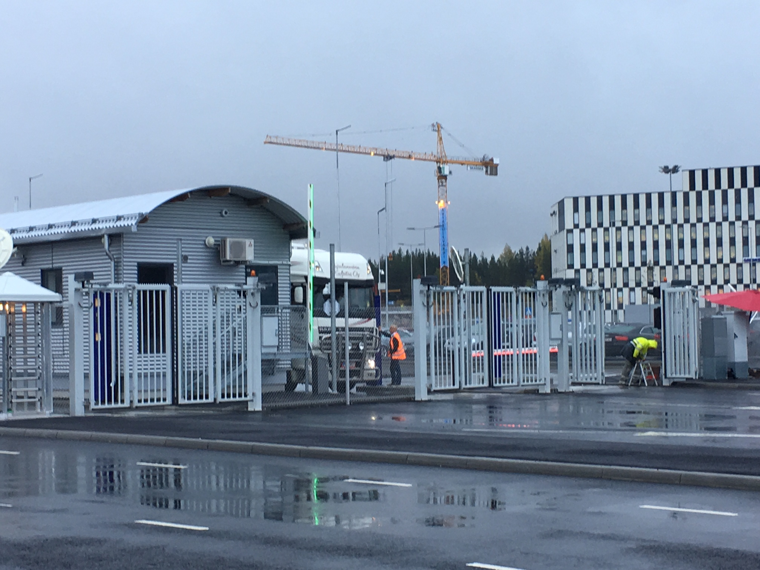
Finnair Cargo
COOL Nordic Cargo Hub
Landside Truck Yard Control

Slide 21
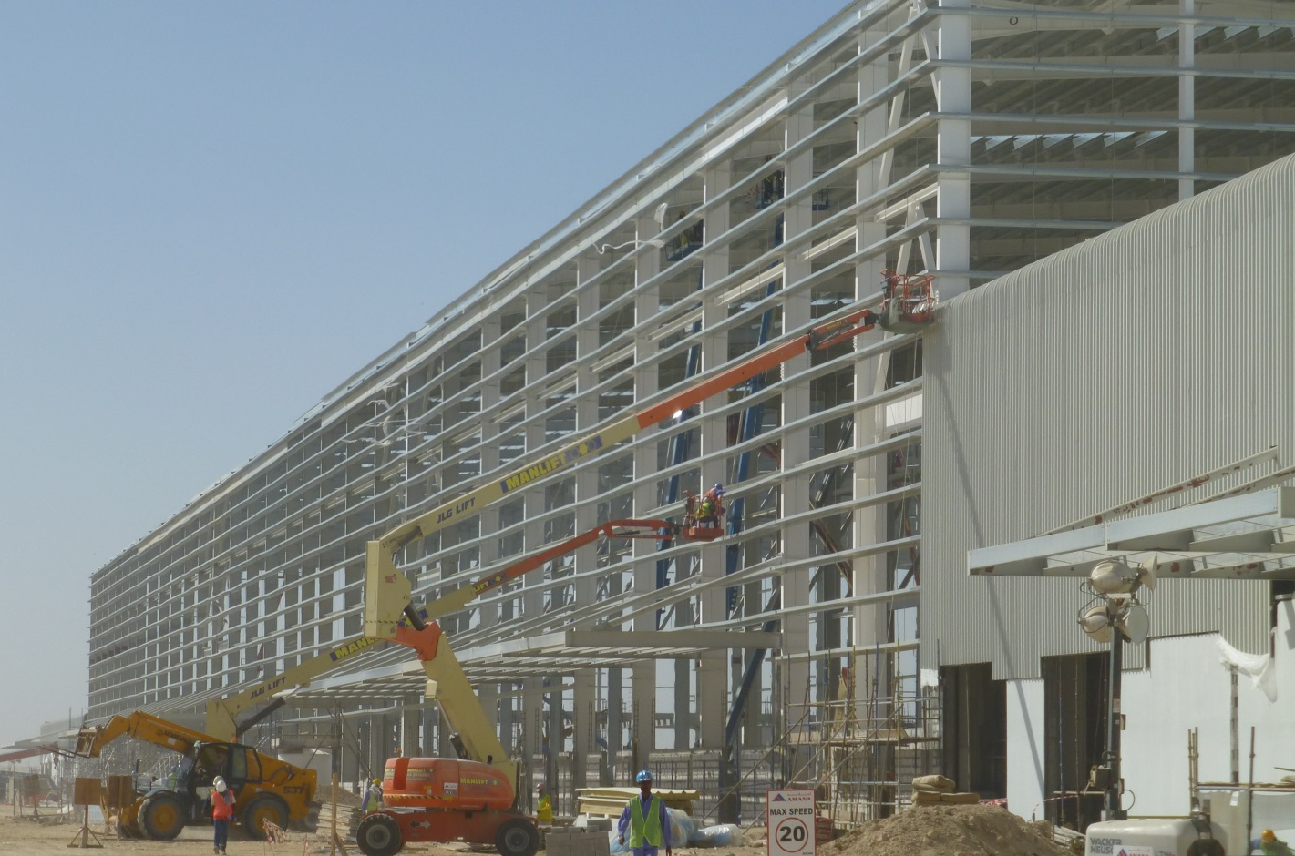
Reference Project
Emirates Sky Cargo Centre, DWC
Lead Consultant MHS & Design
Opening Capacity: 700.000 Tons Annually
Size: 60.000 m²
25.000 m² Cool Processing Area
Largest Cross-docking Area for ULDs worldwide
Shop Test Status (ETV, Key Equipment)
Opening Phase 1: May-2014

Slide 22
Reference Project
Emirates Sky Cargo Centre, DWC
Development of high-speed airside interfacing
800 10ft ULD Storage Positions: 3 x 20 ft ETVs
VNA Shipment System: 3000 locations
Mini-shipment System
Sky Cargo Centre, DWC cool area

Slide 23
Reference Project
Emirates Sky Cargo Centre, DWC
Sky Cargo Centre, DWC ETV Area 800 10ft Locations 4 x 20ft ETVs

Slide 24
Reference Project
Emirates Sky Cargo Centre, DWC
Sky Cargo Centre, DWC Airside ‘Flying Carpet’ Dolly Interface

Slide 25
Reference Project
Changi Airport Singapore
Opening Capacity: 2.5-3.5 Mil. Tons
Interdisciplinary facility for Aircargo Handling, Value-Add processing & Forwarding
Planned opening Phase 1: ~2030
Master Concept planning New Cargo Support Zone, Changi EAST

Slide 26
Reference Project
New Delhi Airport Cargo Village Study
Multi- tenant facility with common/shared automated storage facility

Slide 27
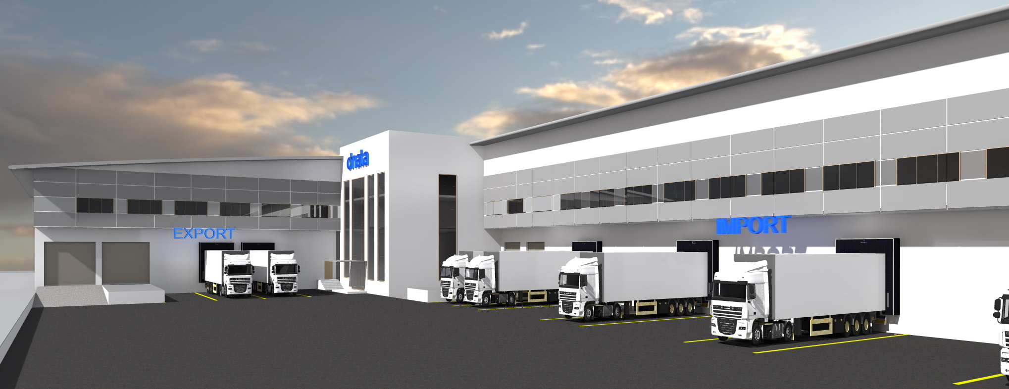
Reference Project
Dnata Cargo Facility, Erbil

Slide 28
Reference Project
New Common Cargo Facility, San Jose, California

Slide 29
Contact
Uwe Beck Managing Director
Uwe.Beck@becon-projects.com
+49-1705261873
Skype: becon.beck

Slide 30
Reference Contacts
Menzies Robert Fordree
robert.fordree@menziesaviation.com
Emirates Cargo Henrik Ambak, SVP EK Cargo
henrik.ambak@emirates.com
Andre Popovich Ventus Capital
APopovich@vent.us
Dnata Stewart Angus, CEO Europe
sangus@dnata.com

Slide 31
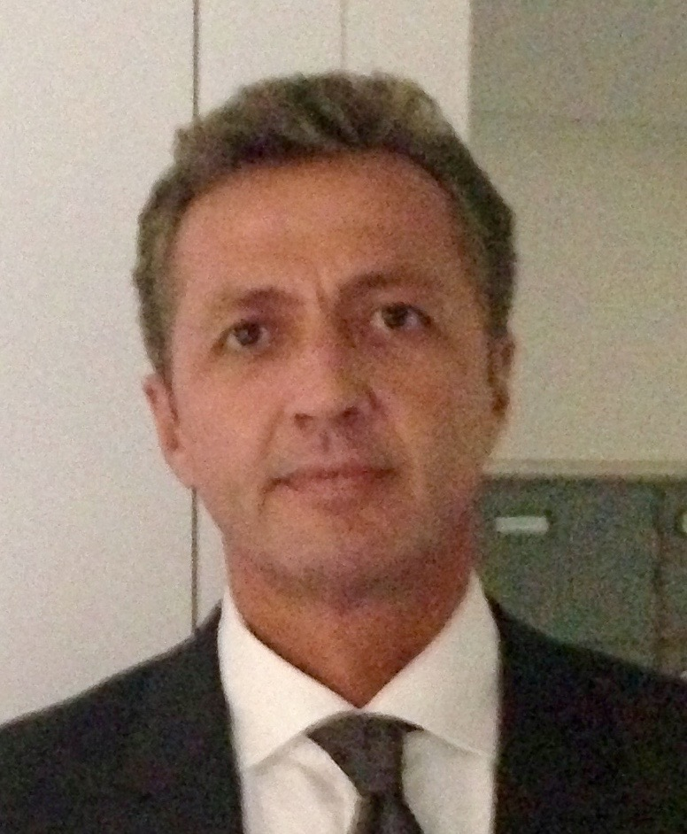
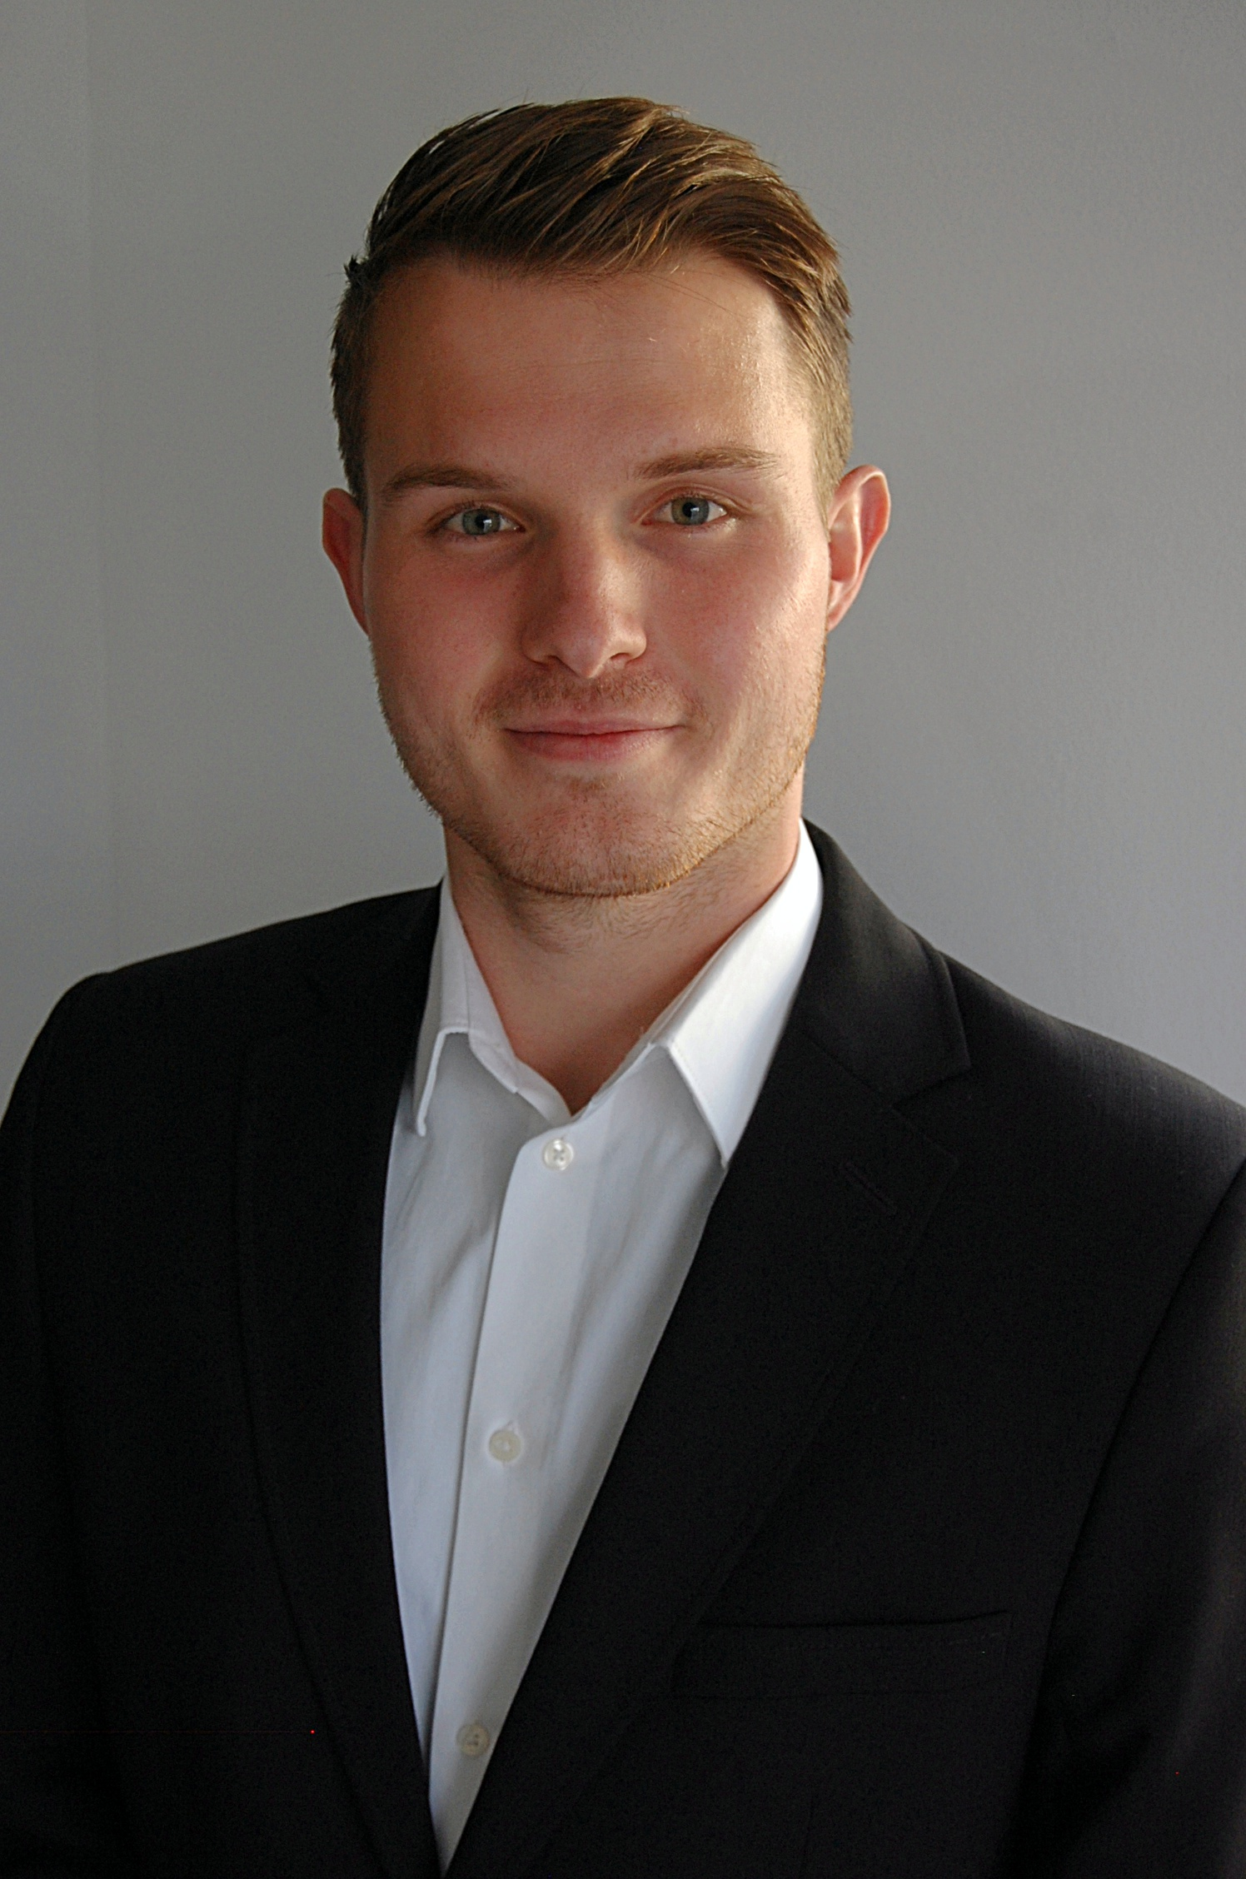
What we offer
Our Project Team
Ralph Goetz Christian Leffler Uwe Beck Robert Ryan

Slide 32
Ready for change?
Taubenberg 9 Ph: +49(0)6126-2265460
65510 Idstein Mobile: +49(0)170-526-1873 Germany www.becon-projects.com
We believe in the power of partnership
uwe.beck@becon-projects.com

